Slide 1

Stacks

Slide 2
Agenda
Introduction to Stacks
Implementation of stack by array
Linked implementation of stack
Applications of stack

Slide 3
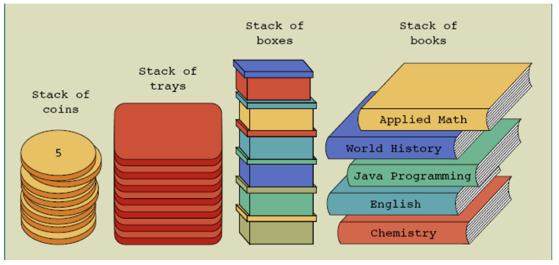
Introduction to Stacks
A stack is a last-in-first-out (LIFO) data structure

Slide 4
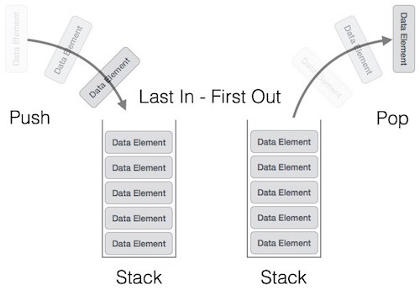
Introduction to Stacks cont.
An ordered collection of same kind of data items
Can be accessed at only one end (the top)
Computers use stacks to implement method calls
Stack are also used to convert recursive algorithms Into nonrecursive algorithms.
Operations performed on Stacks
Push : adds an element to the stack
Pop: removes an element from the stack
Peek: looks at the top of the stack

Slide 5
Why should we learn stacks?
When we need to create an application which utilizes “last incoming data first”.
Example : -
Implementation of back button in browser
Stack can be implemented in two ways :-
By using an array
By using an linkedlist

Slide 6
Implementation of stack by array
Each element of the stack can be assigned to an array slot
The top of the stack is the index of the last element added to the stack
To keep track of the top position, declare a variable called topofstack

Slide 7
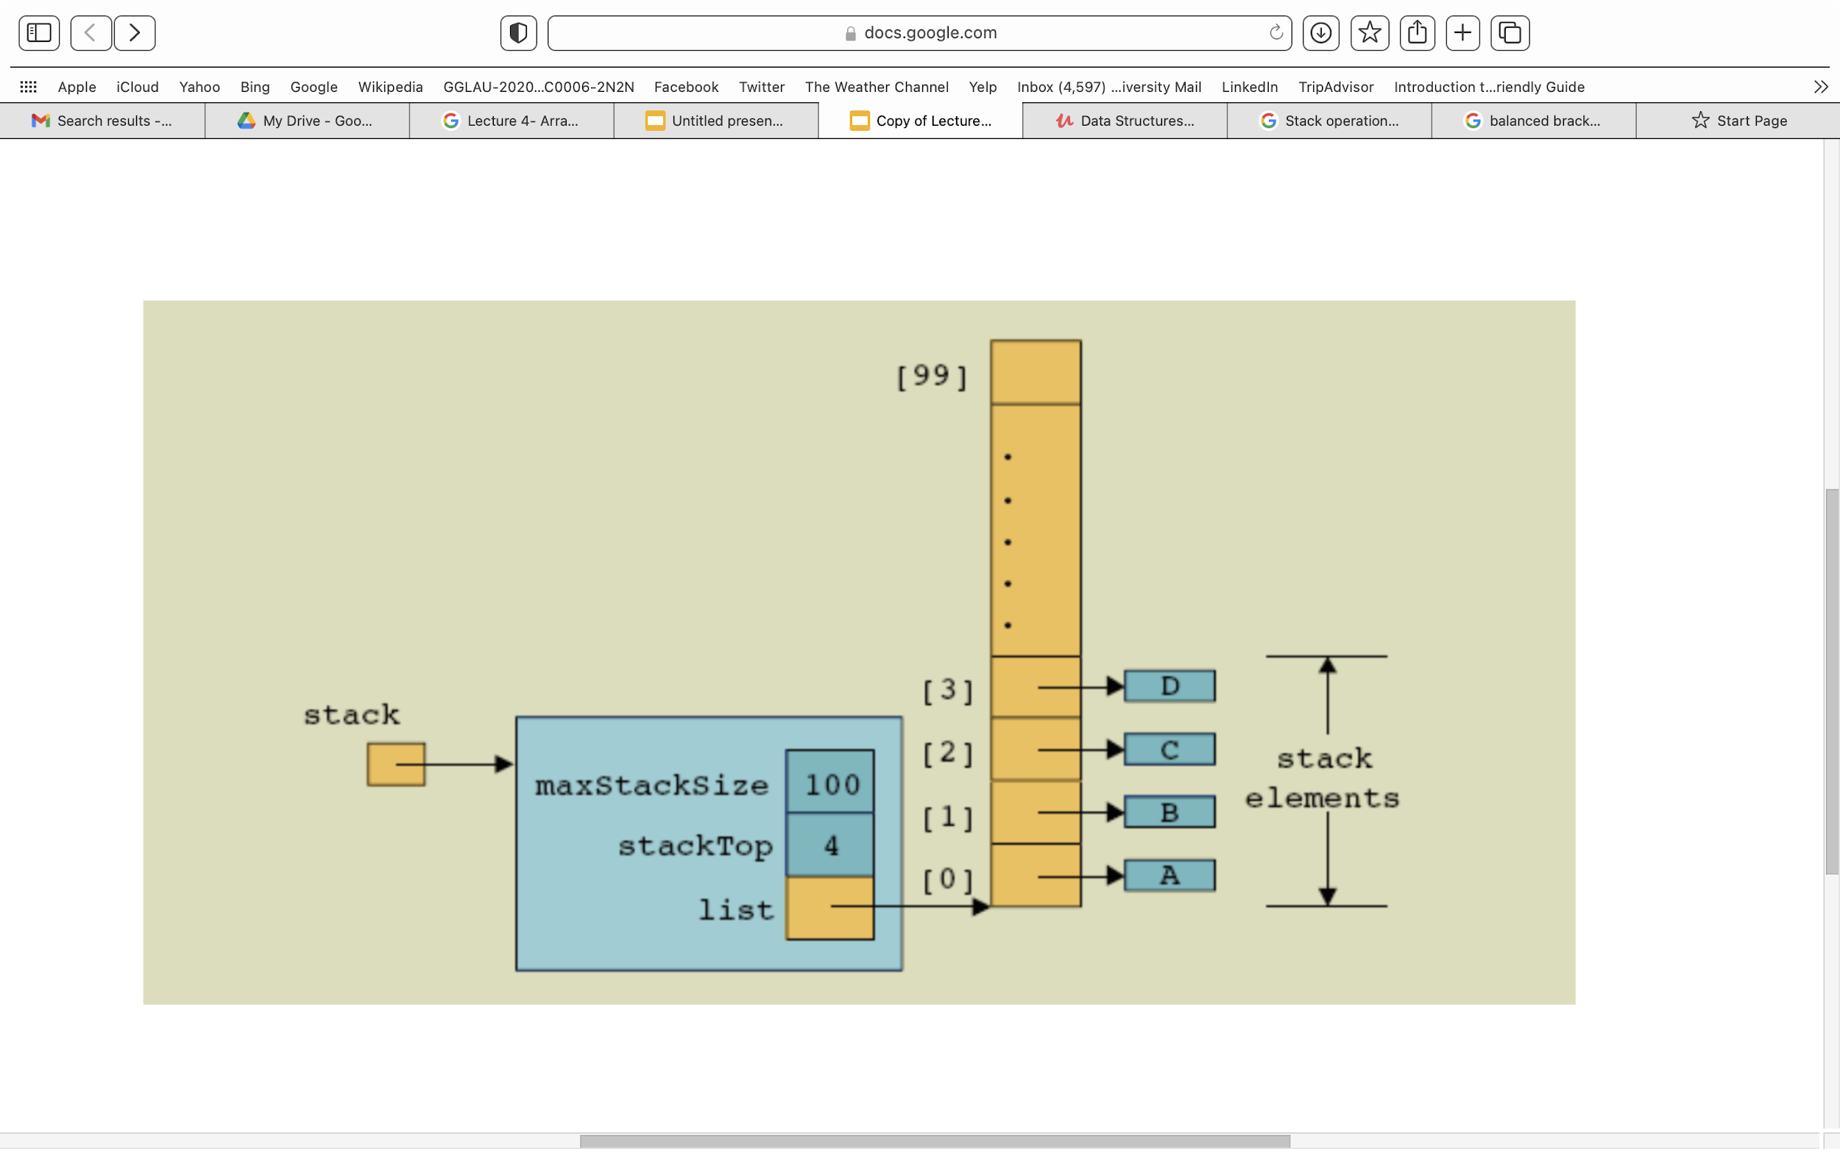
Implementation of stack by array
array

Slide 8
Constructor
public StackByArray(int size)
{
arr = new int[size];
topofstack = -1;
}

Slide 9
Push() Method
public void push( int value)
{
if( topofstack == arr.length-1)
{
System.out.println(“stack is full”);
}
else
{
arr[topofstack+1 ] = value;
topofstack;
System.out.println(“successfully inserted value”);
}
}

Slide 10
Pop() Method
public void push( int value)
{
if( topofstack == -1)
{
System.out.println(“stack underflow error”);
}
else
{
System.out.println(arr[topofstack]);
topofstack--;
}
}

Slide 11
Peek() Method
public void push( int value)
{
if( topofstack == -1)
{
System.out.println(“stack is empty”);
}
else
{
System.out.println(arr[topofstack]);
}
}

Slide 12
Linked Implementation of stack
Arrays have fixed size
Only a fixed number of elements can be pushed onto the stack
Dynamically allocate memory using reference variables
Implement a stack dynamically
Similar to the array representation, stackTop is used to locate the top element
stackTop is now a reference variable

Slide 13
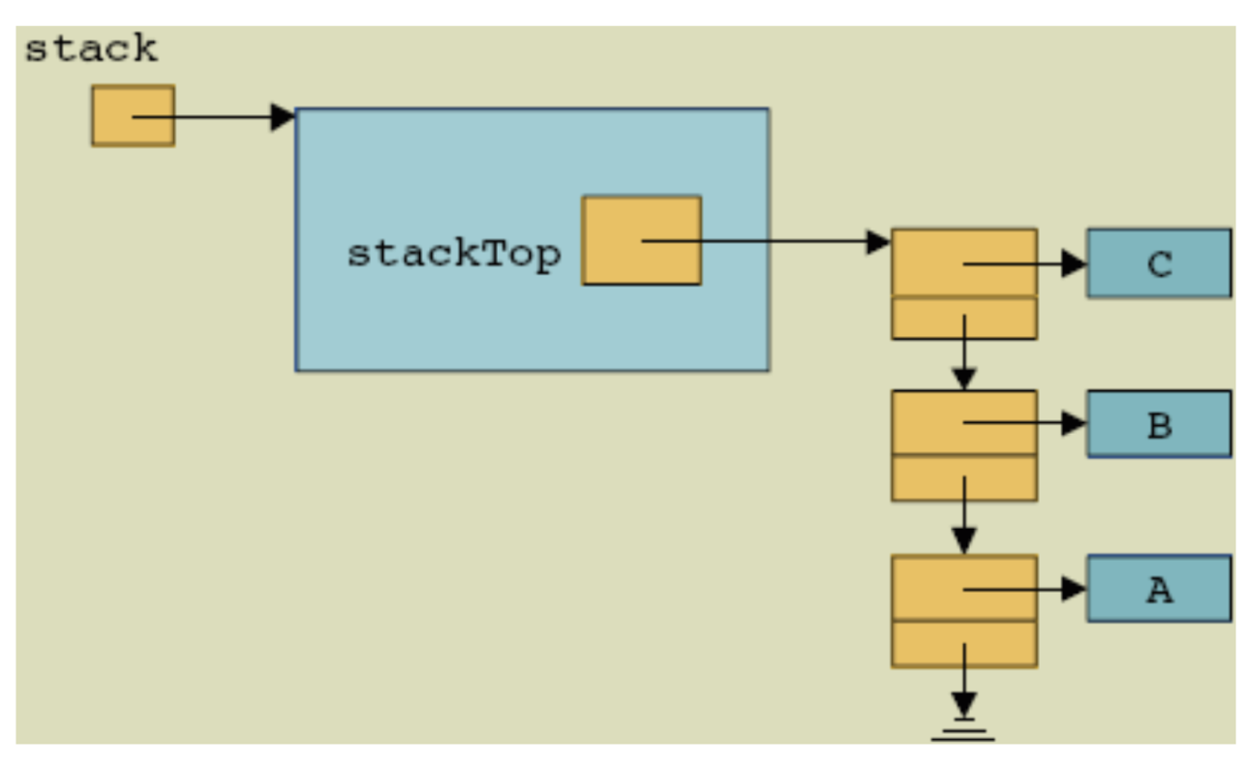
Linked Implementation of stack

Slide 14
Default Constructor
public StackByLinkedList()
{
stackTop = null;
}//end constructor

Slide 15
Empty Stack and Full Stack
public boolean isEmptyStack()
{
return (stackTop == null);
} //end isEmptyStack
public boolean isFullStack()
{
return false;
} //end isFullStack

Slide 16
push() and pop() Method
Public void push(Node newnode)
{
newnode.next = stackTop;
stackTop = newnode;
} //end push
public int pop()
{
int result=0;
if(stackTop == null)
{
System.out.println(“Linked list is empty”);
return 0;
}
else
{
result = stackTop.data;
stackTop = stackTop.next;
return result;
}
} //end pop

Slide 17
Applications of Stacks: Reverse String
A Simple application of stack is reversing strings. To reverse a string, the characters of string are pushed into the stack one by one as the string is read from left to right.
Once all the characters of string are pushed into stack, they are popped one by one. Since the character last pushed int comes out first, subsequent pop operation results in the reversal of the string.

Slide 18
Applications of Stacks: Postfix Expression Calculator
Infix notation
The operator is written between the operands
Prefix or Polish notation
Operators are written before the operands
Does not require parentheses
Reverse Polish or Postfix notation
Operators follow the operands
Has the advantage that the operators appear in the order required for computation

Slide 19
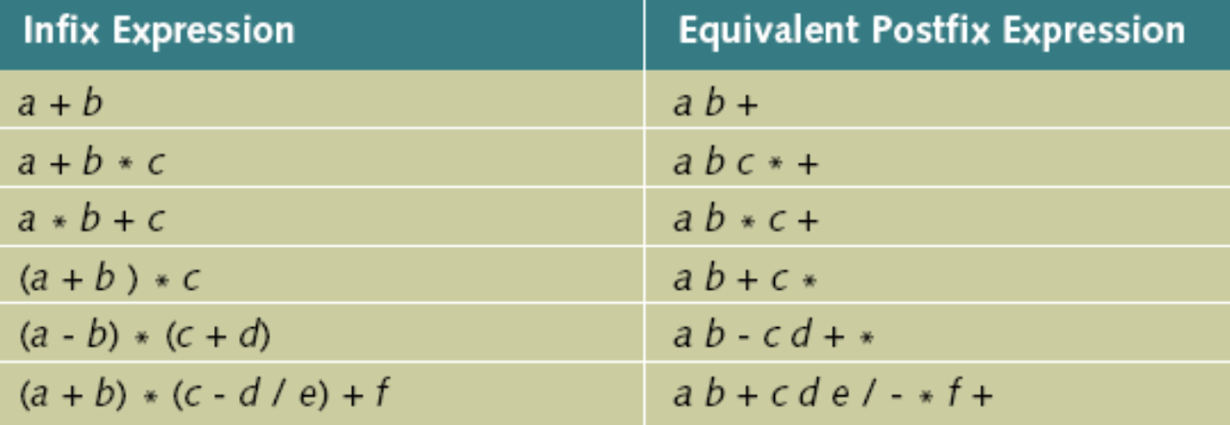
Applications of Stacks: Postfix Expression Calculator cont.

Slide 20
Applications of Stacks: Postfix Expression Calculator cont.
Algorithm to evaluate postfix expressions
Scan the expression from left to right
When an operator is found, back up to get the required number of operands
Perform the operation
Continue processing the expression

Slide 21
Applications of Stacks: Checking the validity of an expression containing nested parentheses.
Stacks are also used to check whether a given arithmetic expressions containing nested parentheses is properly parenthesized.
The program for checking the validity of an expression verifies that for each left parenthesis braces or bracket, there is a corresponding closing symbol and symbols are appropriately nested.

Slide 22
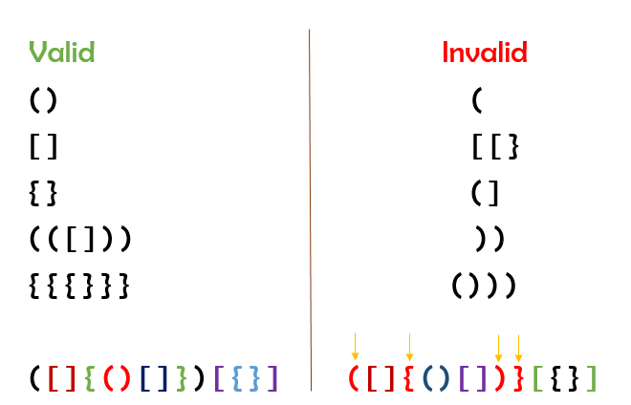
Applications of Stacks: Checking the validity of an expression containing nested parentheses.

Slide 23
Removing Recursion: Nonrecursive Algorithm to print a Linked List Backward
Approach
Get the last node of the list and print it
Traverse the link starting at the first node
Repeat this process for every node
Traverse the link starting at the first node until you reach the desired node

Slide 24
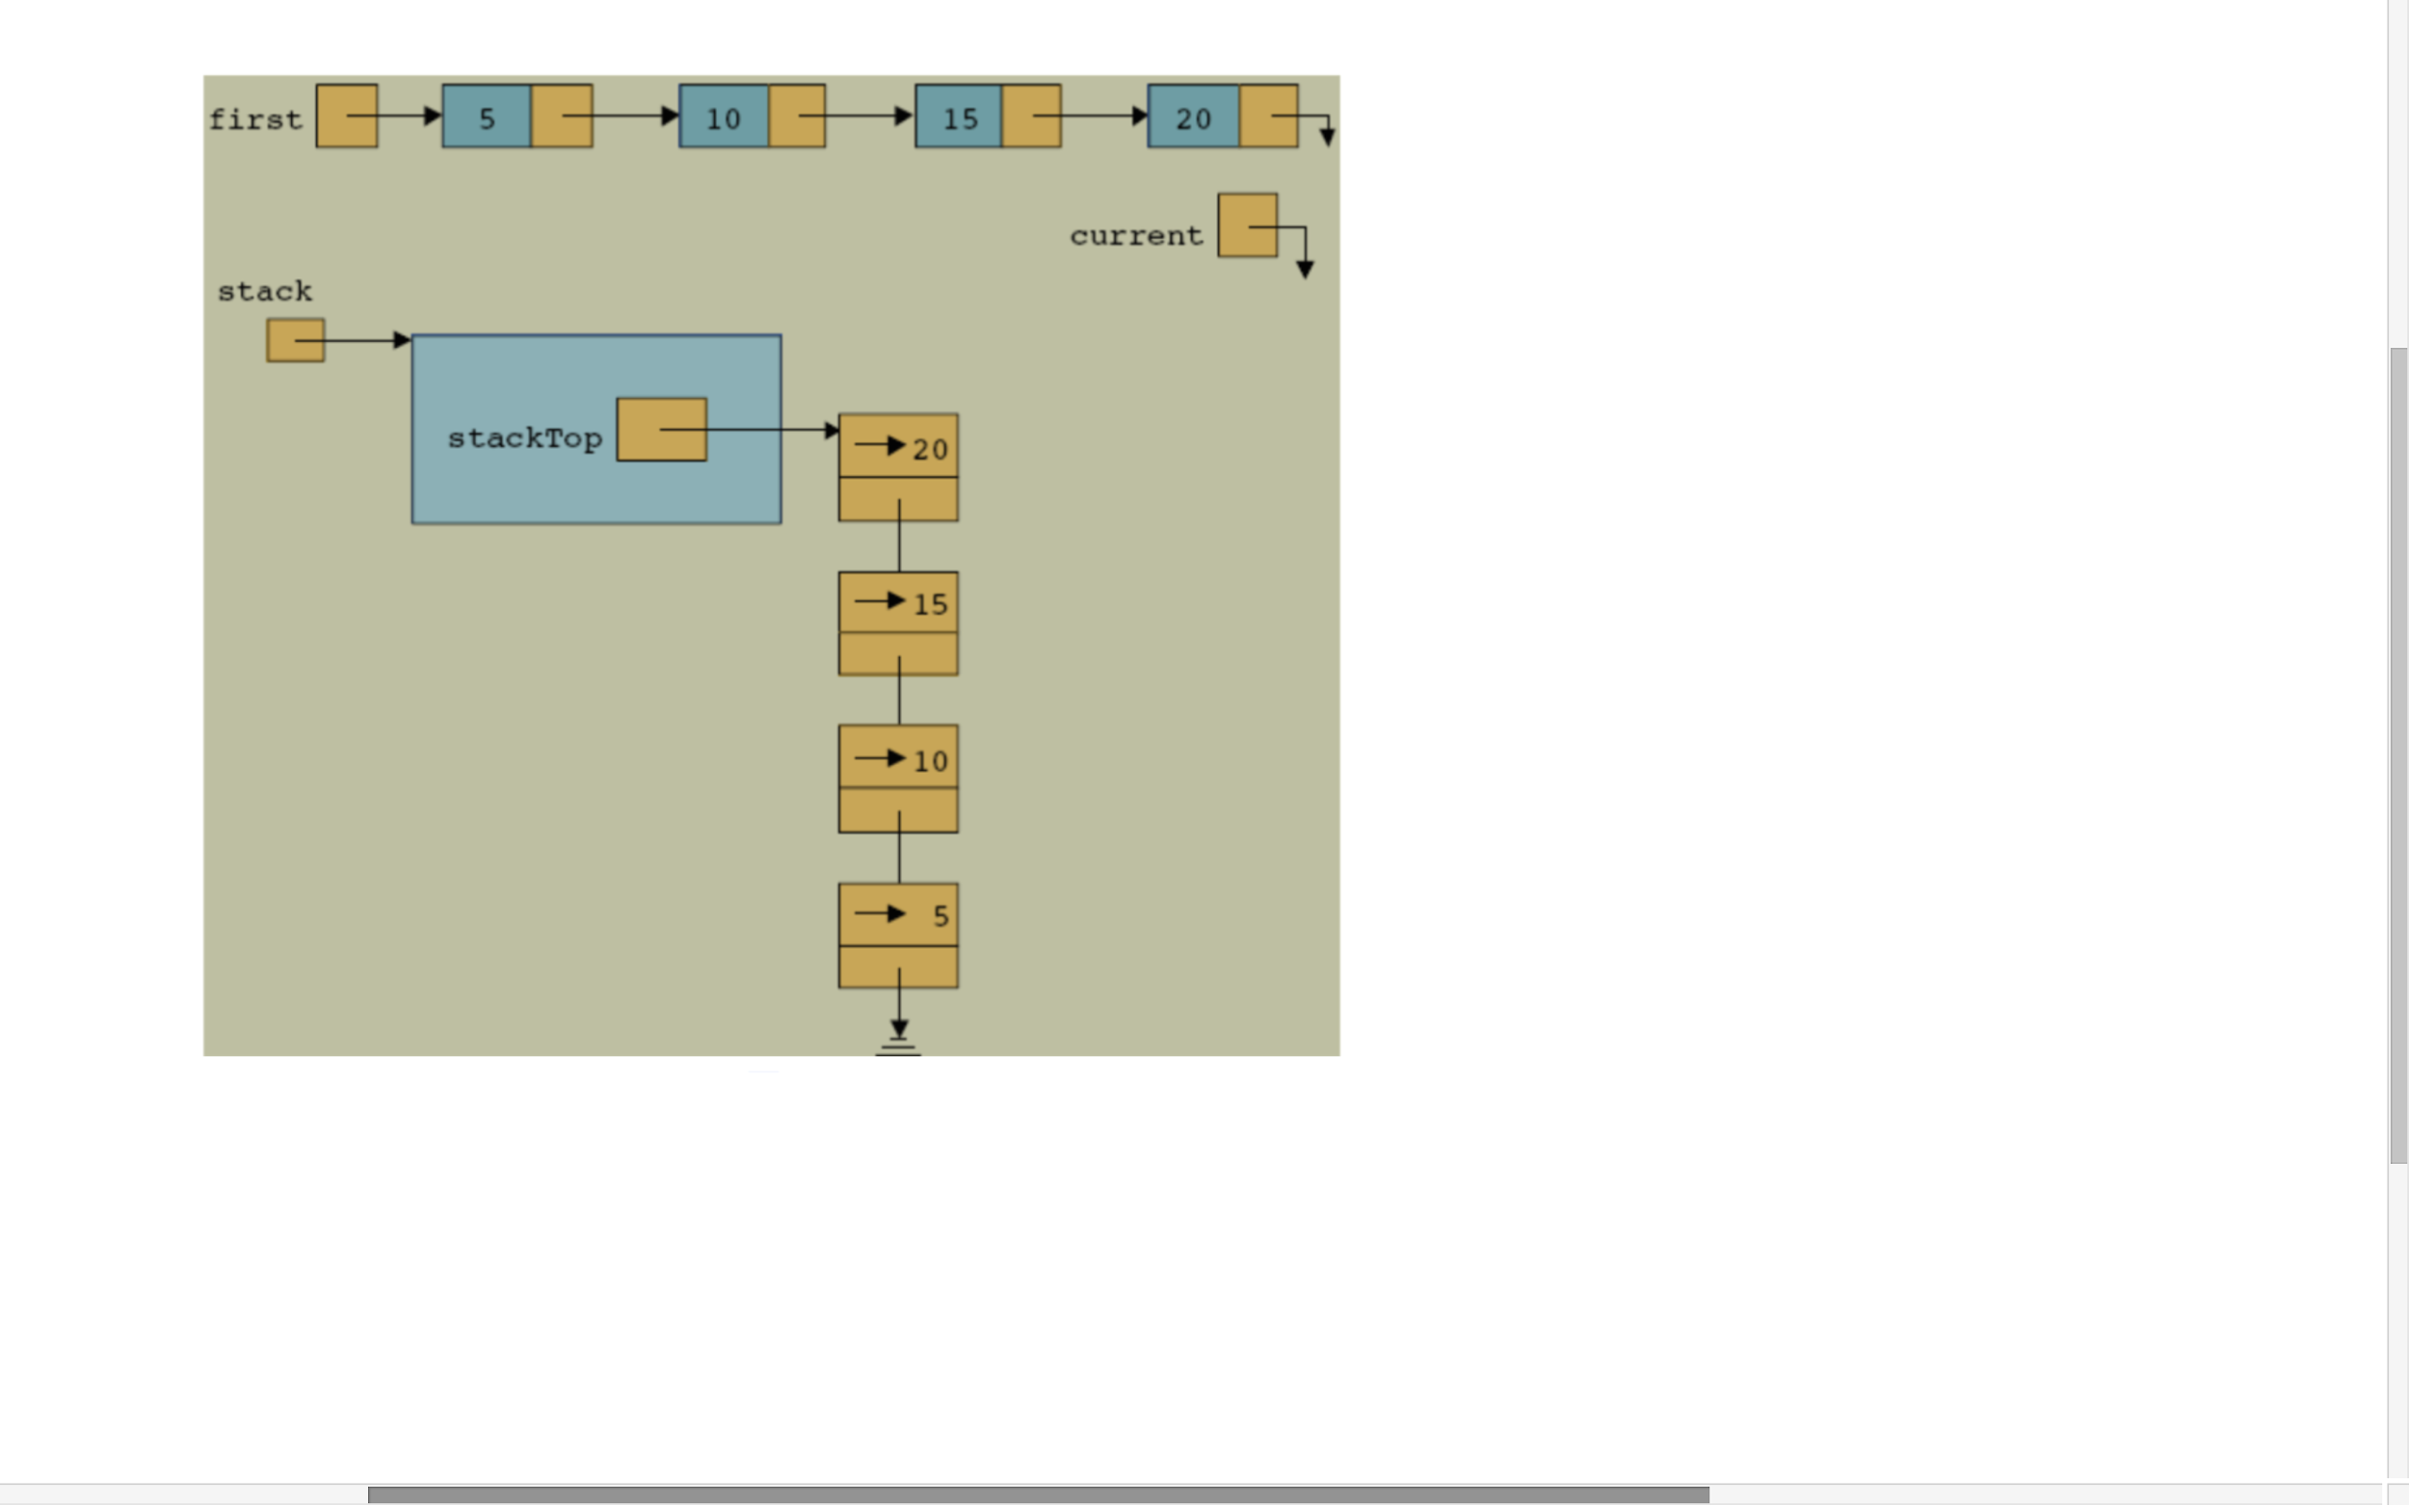
Removing Recursion: Nonrecursive Algorithm to print a Linked List Backward

Slide 25
Applications of Stacks: Run Time Stack
Consider events when a function begins execution
Activation record (or stack frame) is created in Run time stack.
Stores the current environment for that function.

Slide 26
Applications of Stacks: Run Time Stack Cont.
Example
public static void main(String args[])
{
System.out.println(“main method start”);
method1();
System.out.println(“main method end”);
}
public static void method1()
{
System.out.println(“ Method1 start”);
method2();
System.out.println(“ Method1 end”);
}
public static void method2()
{
System.out.println(“ Method2 start”);
System.out.println(“ Method2 end”);
}
push
pop
method2()
method1()
Activation record/ stack frame
main()
Run time stack

Slide 27
References
Hyperskil Academy by jetbrains.
cs.utep.edu Chris Kiekintveld CS 2401 (Fall 2010)
Nyhoff ADTs Data Structures and problem solving , Second edition

